Slide 1

Indoor Plant Monitoring System Using IoT
by
A. Likhitha
Roll No. 204G1A0548
R. Lalitha
Roll No. 204G1A0547
K. Asha Nidhi
Roll No. 204G1A0516
K. Hema Latha
Roll No. 204G1A0539
Under the guidance of
Dr. B. HariChandana M.Tech.Ph.D
Associate Professor
Department of Computer Science and Engineering
Srinivasa Ramanujan Institute of Technology
(Autonomous)
2023 - 2024

Slide 2

Contents
Review-0 comments
Abstract
Problem statement
Objectives of Project
Literature survey for first objective
Objective-1 (Design & Implementation)
Literature survey for second objective
Proposed Work -(Methods to be followed for proposed system)
References
GitHub Link
Queries

Slide 3
Review-0 Comments
Add more links for the literature review, you have done.
What are the ideal temperature ranges for plants to survive?
More details on object detection.
In what way does this project deal with motion detection?

Slide 4
Plant Sustainability
Temperature, Humidity and Moisture Factors For Plant Sustainability
Temperature and Humidity reference
There are typically three main temperature points of plant growth. These refer to the minimal, optimal, and maximum temperature.
Vegetative phase – 25 degrees Celsius and 60-70% humidity.
Flowering phase – 28 degrees Celsius and 40-50% humidity.
Soil Moisture reference
It is important to note that the majority of flowers, trees, and shrubs require moisture levels between 21% - 40%, while all vegetables require soil moisture between 41% and 80%.

Slide 5
Abstract
Nowadays, a lot of individuals are quite interested in doing their own gardening. Indoor gardening has a variety of advantages, including the ability to produce organic vegetables, use of the plants in home design, and air purification. People's busy schedules are the major obstacle to indoor gardening because plants require more attention for their growth and health, necessitating the hiring of a "plant sitter" if they leave on vacation. This problem can be solved by automating the plant monitoring using the "Internet of Things". Utilizing Raspberry pi and variety of environmental sensors, and camera module, to track the temperature, moisture, light and many other aspects and providing data on each of these elements via Blynk app.
Keywords: Indoor planting, Plant sitter, Raspberry pi, Camera

Slide 6
Problem Statement
Due to people's hurried lifestyles, indoor plants don't receive the attention they need, which has an effect on their growth and robustness.
To maintain the plant’s growth, a predetermined temperature, moisture, light and humidity levels as well as to spot bird activity, environmental factors must be continuously monitored and managed.

Slide 7
Objectives of Project
Research Objective-1: To prevent overheating through tracking the temperature using DHT 11 and monitoring the moisture level of the soil using moisture sensor and notifying the user via in-app notification and e-mail through the Blynk app.
Research Objective-2: To water the plants using water pump automatically through assessing the soil's moisture content.To secure the existence of plant through the utilization of a network of various sensors that safe guard against the consequences of bird activity.

Slide 8
Literature survey for first objective
This paper includes integrating the Raspberry Pi as the core component, serving as a unifying element for the entire module. This consolidation incorporates an array of sensors that are linked to the Raspberry Pi. Also discusses, soil moisture sensor's purpose, which is primarily centred on identifying moisture present within the soil. Maintaining the right balance of moisture is essential to ensure proper nutrient absorption and prevent water stress. Soil moisture sensors are devices designed to measure the amount of water present in the soil. [1]

Slide 9
Continued…
This study elaborates a system with various sensors that detect humidity, temperature, and soil moisture. This technology uses IoT (Internet of Things) to irrigate and monitor the plant. Also offers information on the most suitable ranges of the plant's key sustainability parameters. Plant watering and monitoring system technologies will deliver input to the user via smart phones or laptops in this paper. The automated system will eliminate the requirement for man power, lowering the possibility of error. [2]

Slide 10
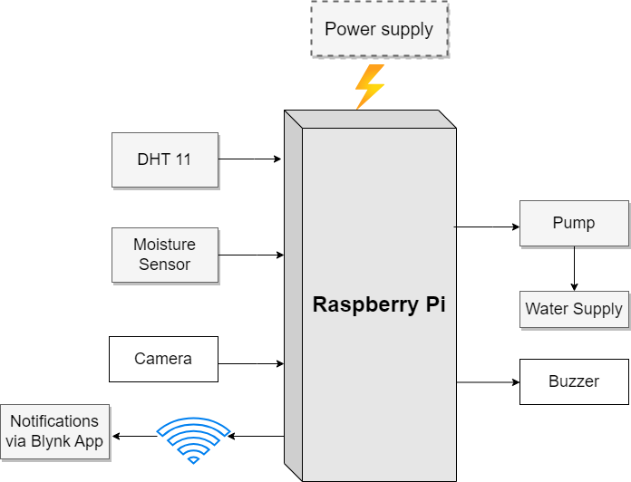
Design and implementation of first objective
Fig-1: Block Diagram

Slide 11
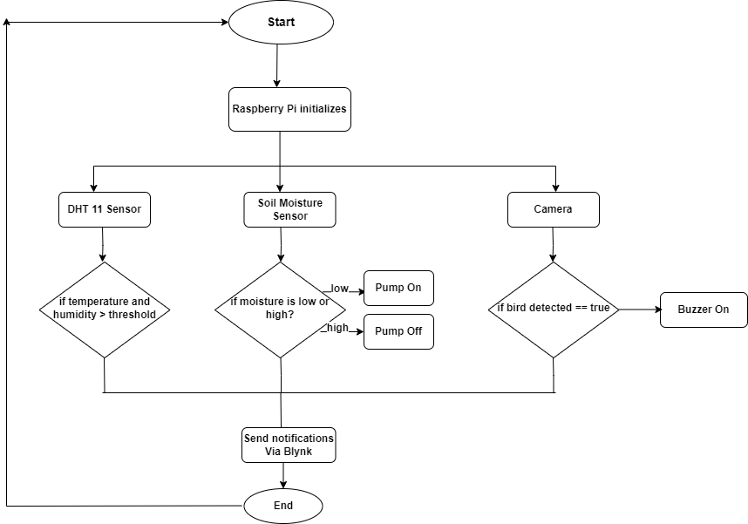
Design and implementation of first objective
Fig-2: Flow Diagram of Plant Monitoring System

Slide 12
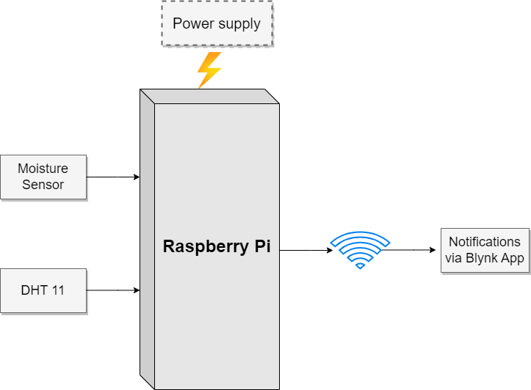
Design and implementation of first objective
Fig-3: Block Diagram for monitoring moisture and temperature

Slide 13
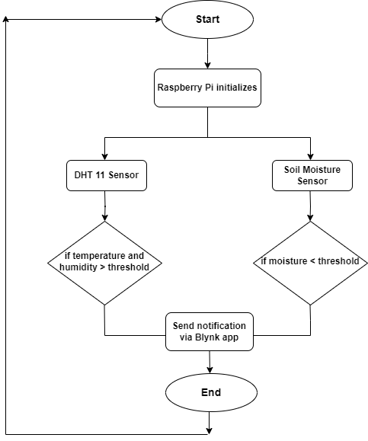
Design and implementation of first objective
Fig-4: Flow Diagram to keep track of temperature and moisture

Slide 14
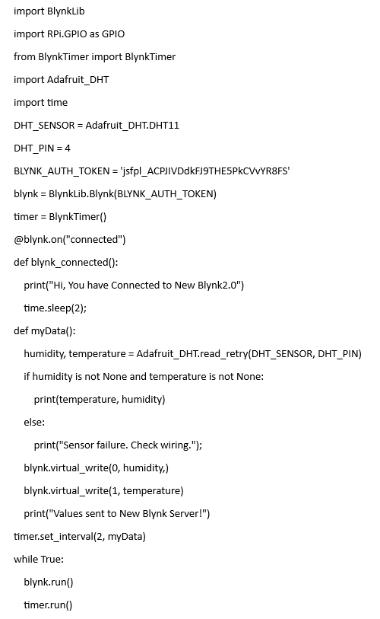
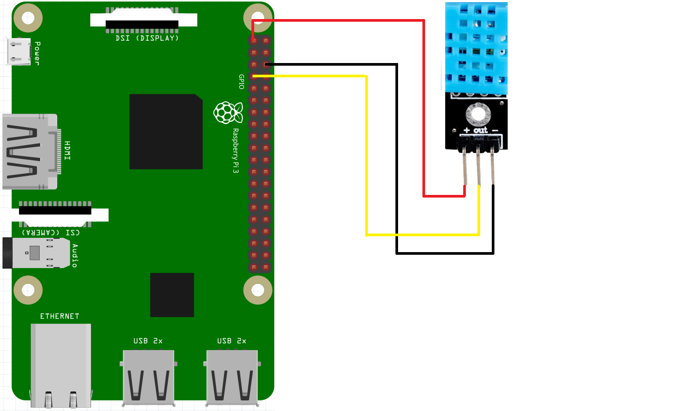
Design and implementation of first objective
Implementation of DHT 11 Sensor

Slide 15
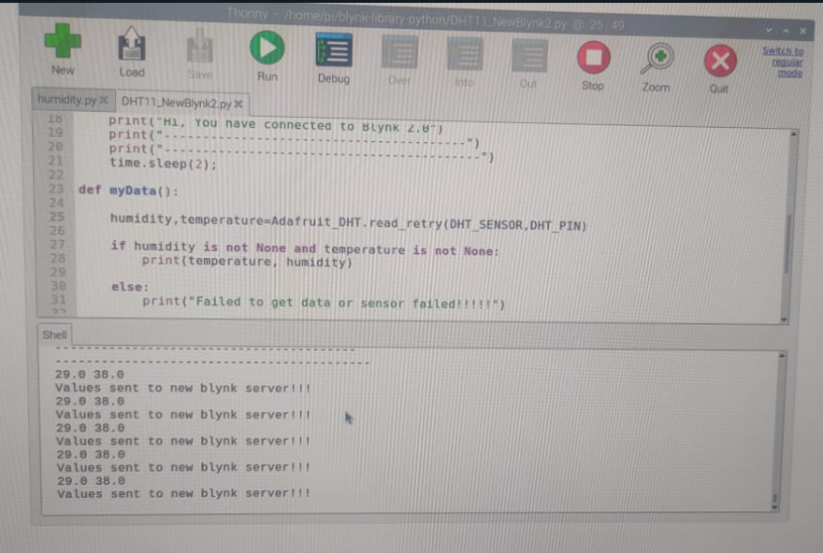
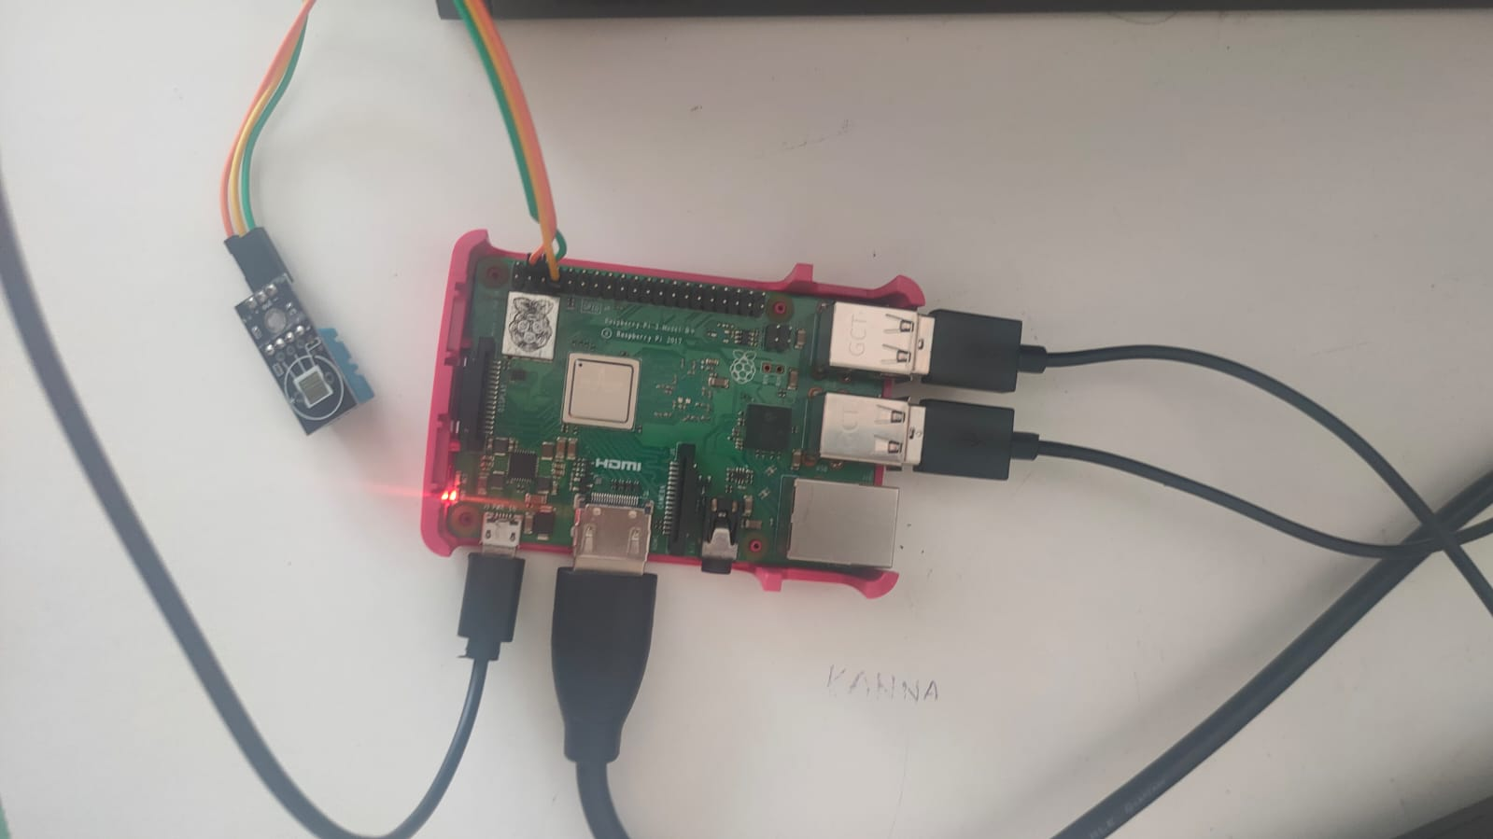
Design and implementation of first objective
Monitoring temperature and humidity through DHT 11 Sensor

Slide 16
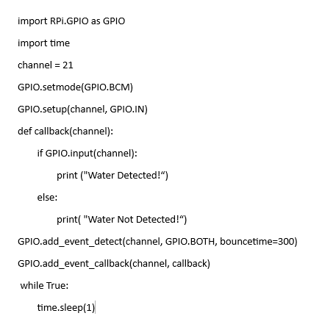
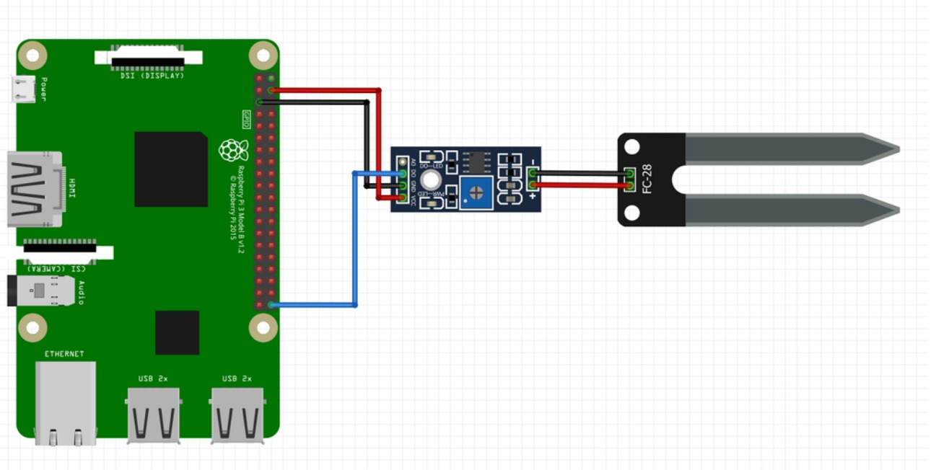
Design and implementation of first objective
Implementation of Soil Moisture Sensor

Slide 17
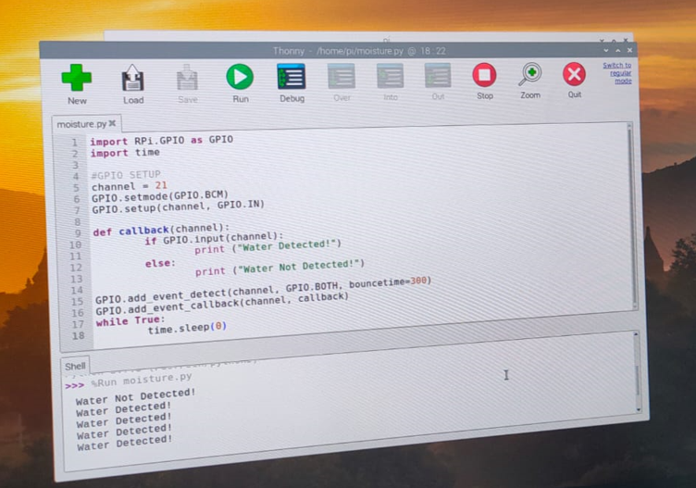
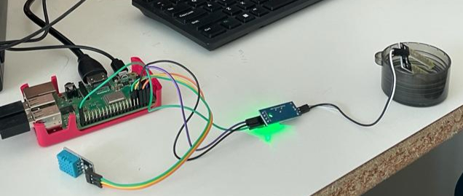
Design and implementation of first objective
Detecting water using Soil Moisture Sensor

Slide 18
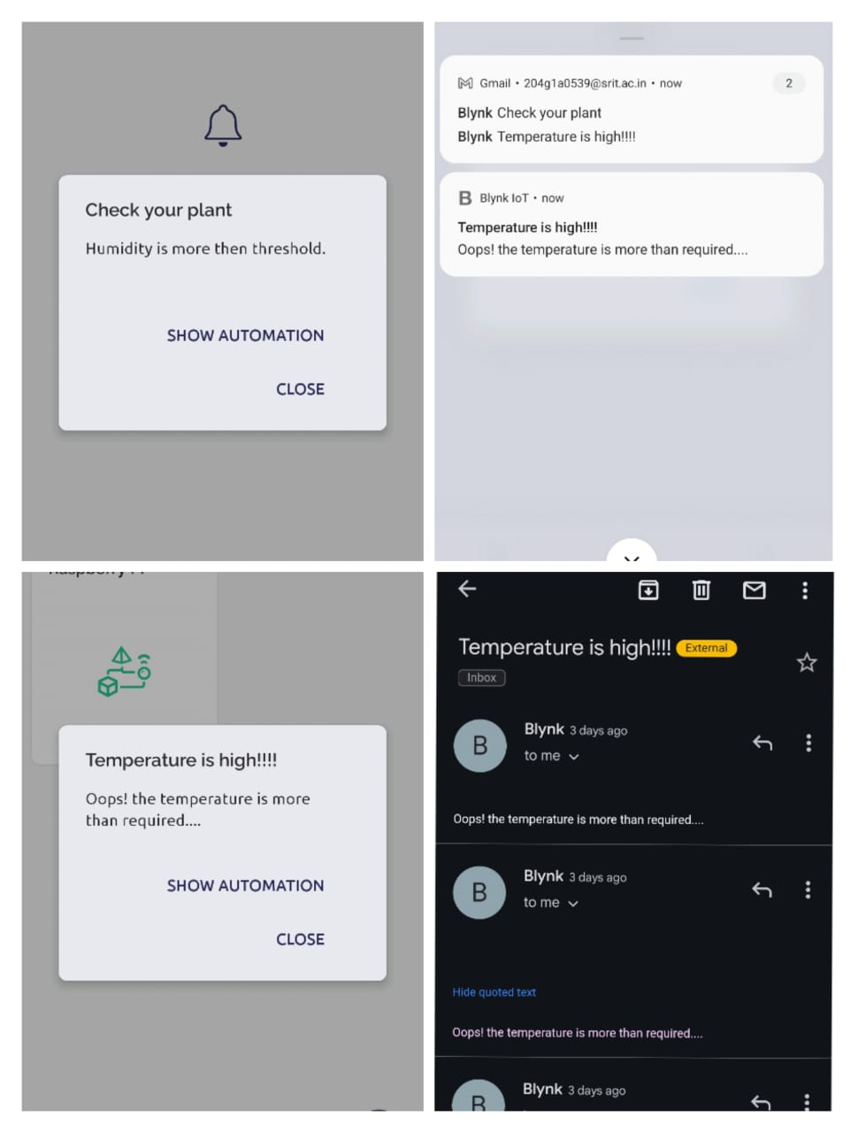
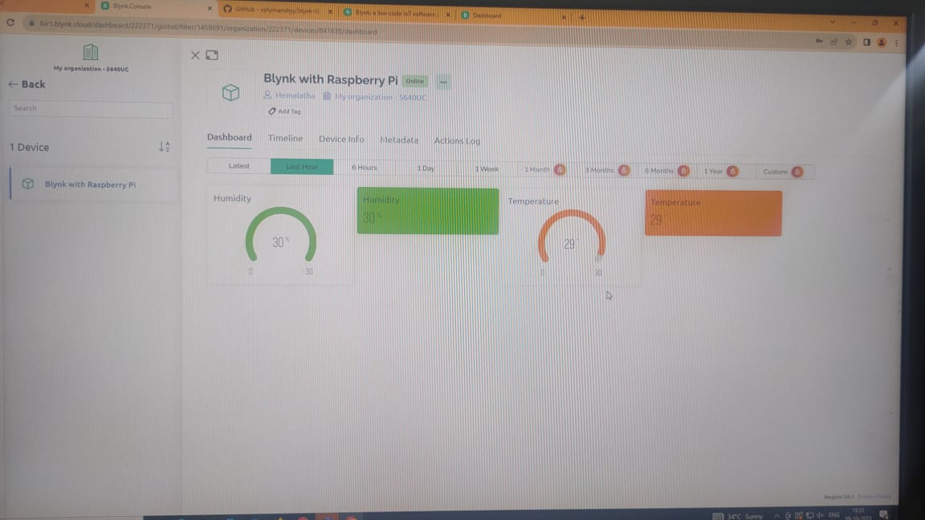
Design and implementation of first objective
Blynk 2.0 in-app notifications and E-mails

Slide 19
Literature survey for second objective
This paper is divided into three divisions: animal detection and identification (to detect and identify the presence of animals), alarm (to activate the buzzer to keep the animal away from the field), and GSM module (to send alert messages to the authorized person). When an animal enters the field, the sensor detects its presence. It begins calculating the distance and sends the signal to the camera to begin photographing. This image is then compared to the previously saved dataset, and the animal is identified. When the distance exceeds the threshold value, the buzzer sounds and an alarm message is sent to the appropriate people. [3]

Slide 20
Continued…
This research paper illuminates the utilization of the Blynk app within a plant monitoring system, showcasing its widespread adoption as a convenient approach for remotely overseeing and managing plant conditions. The discussion underscores the prevalent adoption of Blynk as a user-friendly and effective avenue for remotely managing and monitoring plant conditions. Blynk emerges as a prominent IoT platform, empowering users to craft personalized mobile applications tailored to their IoT ventures.[4]

Slide 21
Proposed System
To address the limitations of the existing system, we propose implementing a comprehensive solution, that employs a combination of various environmental sensors, which will constantly monitor variables such as humidity and temperature fluctuations, and smart gadgets like camera module to track the presence of birds and make a buzzer sound.

Slide 22
References
[1]. Zuraida Muhammad, Muhammad Azri Asyraf Mohd Hafez, Nor Adni Mat Leh, Zakiah Mohd Yusoff and Shabinar Abd Hamid, “Smart Agriculture Using Internet Of Things with Raspberry Pi”, 10th IEEE International Conference on Control System, Computing and Engineering (ICCSCE2020) pp. 85-90, August. 2020.
[2]. Ms. Yogeshwari Barhate, Mr. Rupesh Borse, Ms. Neha Adkar and
Mr. Gaurav Bagul, “Plant Watering and Monitoring System Using IOT and Cloud Computing” International Journal of Scientific Development and Research vol. 5, pp. 157-162, April. 2020.

Slide 23
Continued…
[3]. Selvamuthukumaran N, Evangeline Sneha J, Thriambika K B and Vishali Babu B, “Intelligent Animal Detection System Using IOT and Deep Learning” International Research Journal of Modernization in Engineering Technology and Science, vol. 3, pp. 2433-2438, April. 2021.
[4]. Priyanka S Talekar, Abhishek Kumar, Amit Kumar, Manish Kumar and Md. Irfan Hashmi, “Smart Irrigation Monitoring System Using Blynk App” International journal of Innovative Science and Research Technology, vol. 6, pp. 1353-1355, July.2021.

Slide 24
Continued (other references used)
[5]. R Lathesparan, A Shranjah, R Thushanth, S Kenurshan, MNM Nifras and WU Wickramaarachi, “Real-time Animal Detection and Prevention System for Crop Fields”, 13th Internationl Research Conference General Sir John Kotelawala Defence University, pp. 70-78, June 2021.
[6]. Y. Manoj, T. Sai Naveen Kumar, Sk Adeeb Jainab, T. Sailaja and A. Anasuyamma, “Greenhouse Monitoring Using Raspberry Pi”, International Journal of Creative Research Thoughts, vol. 11, pp. 429-433, May 2023

Slide 25
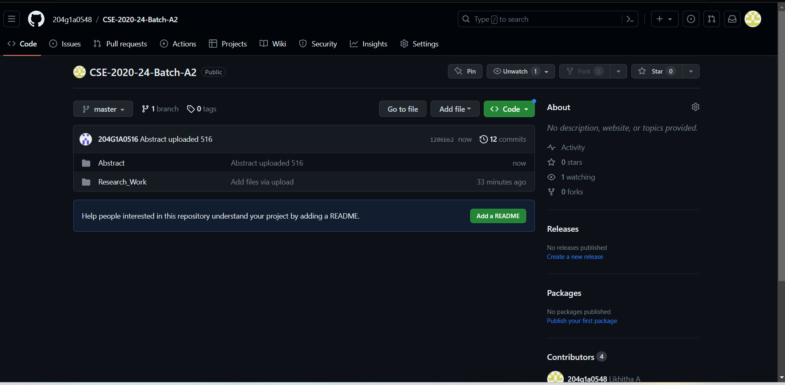
Git Hub Dashboards of each student
Git Hub Link: https://github.com/204g1a0548/CSE-2020-24-Batch-A2.git

Slide 26
Any Queries?

